Slide 1

JDBC Program
Group 10 E
Edwin Ramos, Jay Mistry, Michael Chang, Bing Gao, Akashdeep Singh

Slide 2
MAIN GOALS FOR JDBC APPLICATION
Easy to use and compact User Interface to not get in the way.
Simple and intuitive Program, straight to the point and streamlines your querying process to get in and get out quick.
Design an Application that is modular enough to be greatly expanded with ease throughout the semester.

Slide 3
Project Key Developers
Edwin Ramos - Lead Developer
Build the jdbc structure; Modulate application for easy integration of new features.
Jay Mistry - Secondary Developer
Integrate new features; Keep up to date with the code; Documentation;
Others:
Maintain high level understanding of the code and application.

Slide 4
Project Planning and To-do List
Database Selection Dialogue: Since the group shares an identical SQL Server set up, streamline the authentication process and allow the user to just select the database they need to query.
Query Input Dialogue: After we select the appropriate database, we can easily paste whatever query we need to execute in a dialogue box.
Results Table: After we provide a query to execute, we show the user the results of their query.
To-do:
Refactor Code make use of Jframes and Action Listeners to expand utility beyond what dialogues are capable of.
Add a custom authentication page in case anyone should want to change their database settings.

Slide 5
Group Communication
All communication was done remotely via Discord.
Established an open and honest atmosphere and rapport, encouraged others to speak up.
Meetings every Tuesday, Thursday and One weekend day to discuss progress and deadlines.
Set goals and held accountability of each other.

Slide 6
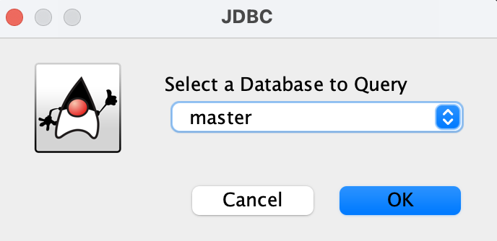
JDBC Project Demo (Database Selector)
Since we all shared the same Database set up, we can skip any kind of configuration in favor of working on more pressing matters on the project.
We can immediately select the database we wish to query against.
Pressing okay will take us to query dialogue.
Pressing cancel will exit the program entirely.

Slide 7
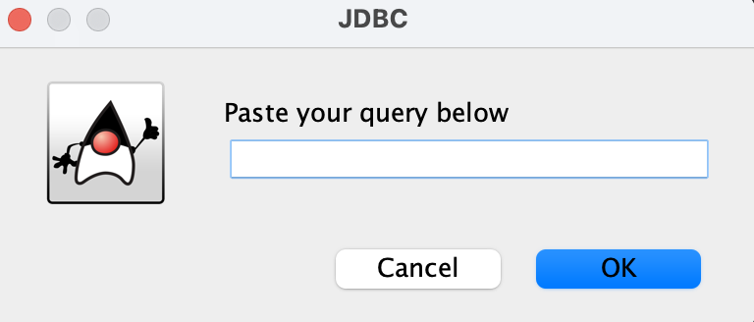
JDBC Project Demo (Query Page)
This is a simple page that allows for you to just enter the query you wish to execute
Pressing okay will execute the query against the chosen database, and take you to a results page granted nothing is wrong with your query.
Pressing cancel will exit the program entirely.

Slide 8
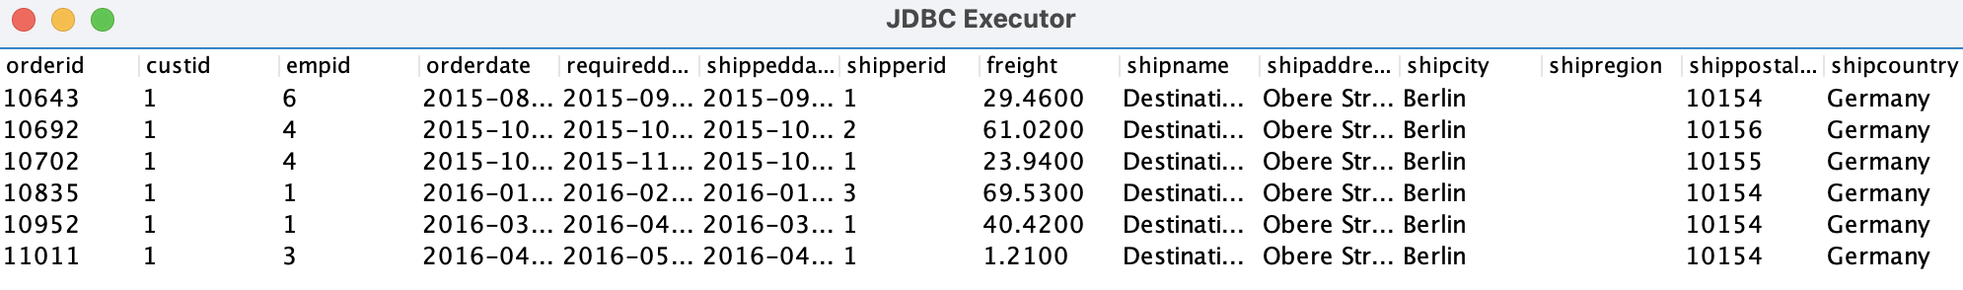
JDBC Project Demo (Results Page)
This page will display the results of your query, you can scroll them if you have a large dataset.
Pressing any one of the upper left hand buttons will do their standard actions of exit, minimize and enlarge.
There are plans to expand the application and make it more robust.

Slide 9

Thank you!

